Slide 1
SOCIAL DISTANCE ANALYZER
Presentation by:
Swarnim Yadav – Priya Adarsh – Alankrita Singh

Slide 2
INTRODUCTION
Digital technologies can be used to strengthen pandemic management, and future preparedness for COVID-19 and other infectious diseases.
A deeper understanding of the epidemic suggests that the risks of virus spread can be minimised by avoiding physical contact among people.
In the area of machine learning and computer vision, there are different methods that can be used for object detection. These methods can also be applied to detect the social distance between people.

Slide 3
The following points summarizes the main components of this approach:
Deep learning has gained more attention in object detection and was used for human detection purposes.
Develop a social distancing detection tool that can detect the distance between people to keep safe.
Evaluation of the classification results by analyzing real-time video streams from the camera [1].
The purpose of this project is, therefore, to provide a deep learning platform for social distance tracking. To accomplish this objective of social distance monitoring, we have used a framework, YOLOv3 to identify humans in video sequences

Slide 4
MOTIVATION
In the present scenario, social distancing has proved to be one of the most exquisite alternative methods as a spread stopper.
Social distancing helps to lessen physical contact or interaction between possibly COVID-19 infected persons and healthy individuals.
This is a prominent way to break the chain of contagion [2].

Slide 5
METHODOLOGY
An open-source object detection network based on the YOLOv3 algorithm is used to detect the pedestrians in the video frame.
From the detection result, only pedestrian class is be used and other object classes are ignored in this application.
Bounding box that best fits for each detected pedestrian is drawn in the image, and the data of the detected pedestrians is used for the distance measurement.

Slide 6
YOLO (You only look once)
YOLOv3 algorithm employs convolutional neural networks (CNN) to detect objects in real-time.
Object detection in YOLOv3 is done as a regression problem and provides the class probabilities of the detected objects..
The algorithm requires only a single forward propagation through a neural network to detect objects. This means that prediction in the entire image is done in a single algorithm run. The CNN is used to predict various class probabilities and bounding boxes simultaneously [3].

Slide 7
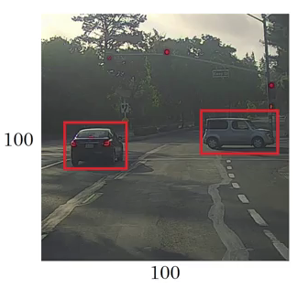
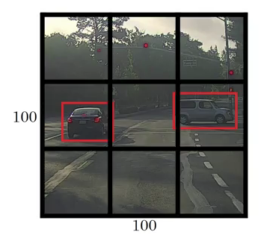
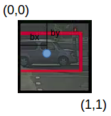
First it takes the image Then it divides the image YOLO then predicts bounding
the as input into grids boxes and their corresponding
class probabilities for objects

Slide 8
PROPOSED MODEL
The work is implemented using the Python programming language.
Procedure for object detection:
Input Acquisition
A pre-recorded video is loaded as an input and further processing is done by the YOLOv3 algorithm.
Pedestrian Detection
The YOLO algorithm is used for object detection by taking an input and simultaneously learning bounding box coordinates (tx, ty, tw, th), object confidence and corresponding class label probabilities (P1, P2, …, Pc).

Slide 9
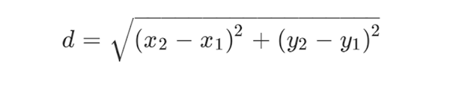
Distance Measurement
The distance between every pedestrian pair can be computed and the distance is scaled by the scaling factor estimated from camera view calibration. The distance is calculated by using the following formula [1]:
Violation Detection
Based on the distance measured, the bounding boxes are marked as green, yellow and red indicating safe zone, abnormal zone and unsafe zone respectively.

Slide 10
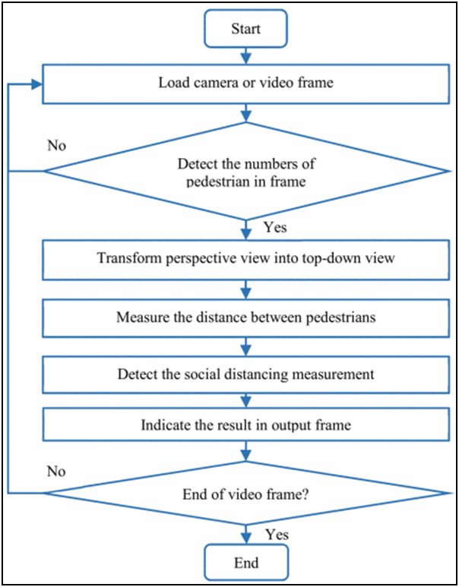

Slide 11
Experimental Results
In this section, we have provided a description of the following use cases of the project-
Human count
Threshold limit
Alert function
Abnormal violations
Region of interest

Slide 12
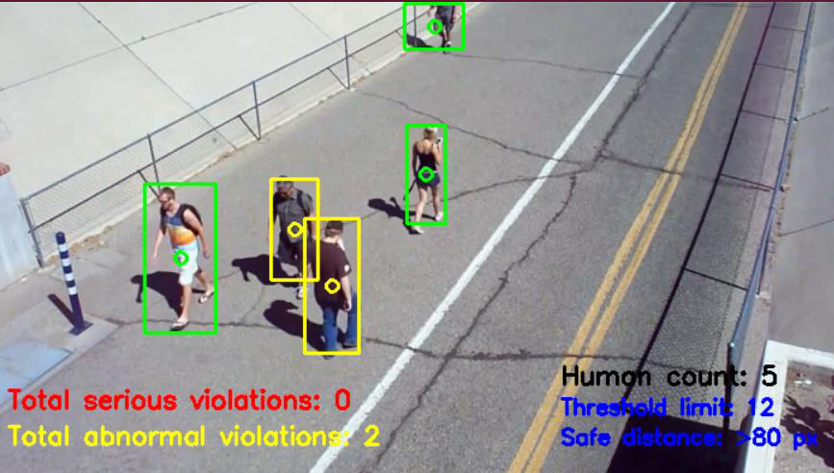
In the above snapshot, we can see total human count is 5 which is perfectly accurate as per the video snippet provided.

Slide 13
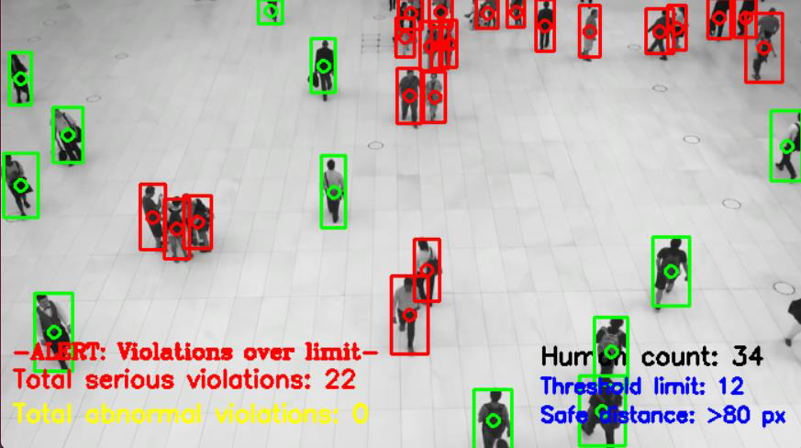
In the bottom right corner of the snapshot are the parameters of threshold that has been set to 12 which signifies that atmost 12 violations can be tolerated with a parameter of maximum distance of 80px

Slide 14
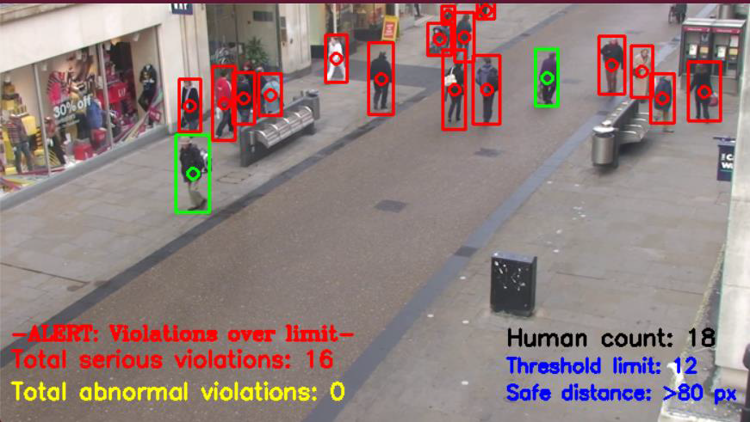
In case of abnormal violations, we have provided the option for turning on the alert function to true/false, which will display the alert message as “ALERT: Violations over limit” on the output screen.

Slide 15
The above snapshot of the output shows the serious violations(as red frame) , abnormal violations(as yellow frame) and the safe zone(as green frame). The set parameters of the serious and abnormal violations are mentioned in the bottom left corner of the output snippet.

Slide 16
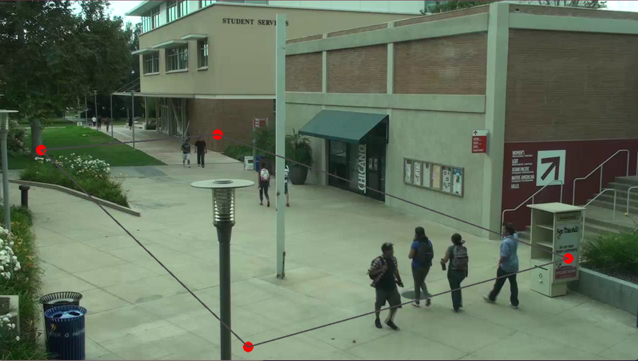
To achieve the restricted field of visualization (Region of interest) which is set by the user, the user draws four points(red) which is termed as Region of interest (ROI) here.

Slide 17
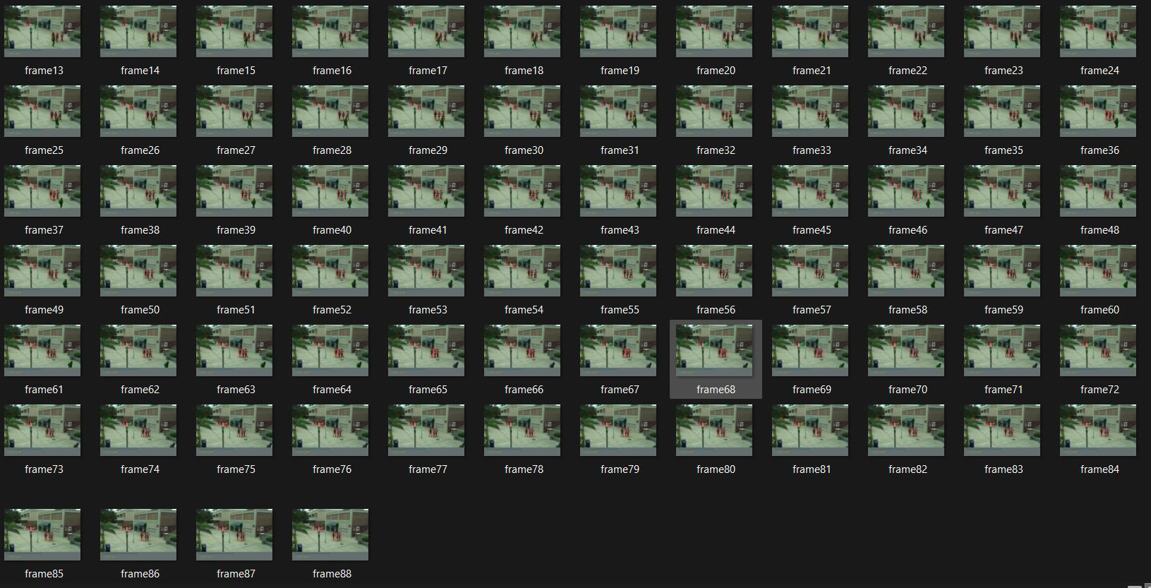
The above snapshot is of the output folder of the project which captures and stores the output frames per second and it continues to store the output frames until the process is killed.

Slide 18
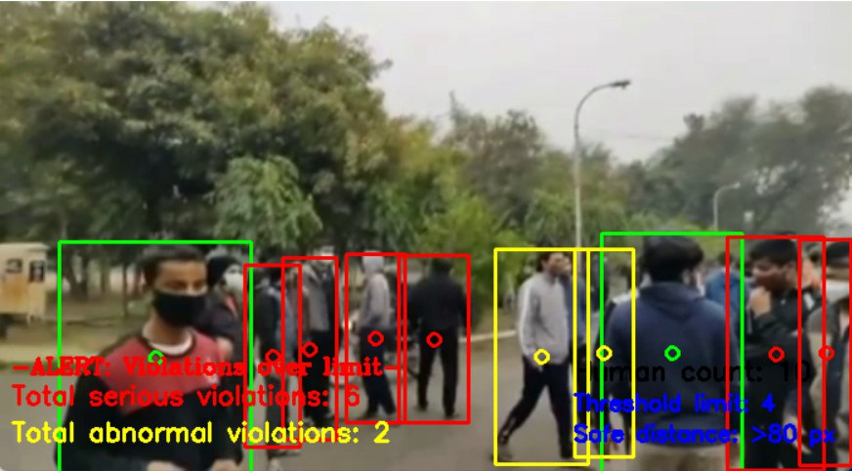
The above snapshot was taken around January 2022 in our college campus during the third wave of covid-19. At this time, we were in our initial phase of the project and we took the opportunity to capture this video and later we performed an analysis on this video so that we can closely relate and associate with the situation of how serious and deadly surrounding we create for ourselves as well as for others.

Slide 19
FUTURE WORKS
In our project we have made space for real time monitoring of the pedestrians by providing camera URL variable in config file, in which if we provide secure url for the camera.
The main function would run inference on the reference of the camera otherwise it would run inference on the reference of the stored video file.

Slide 20
CONCLUSION
This project has presented an intelligent system for people tracking and social distance classification.
The proposed technique, YOLOv3 has achieved promising results in identifying people walking too close and violating social distancing norms.
Furthermore, this approach can be implemented in distributed video surveillance system which may be useful in tracking attendance, detecting possibility of stampede, etc,

Slide 21
REFERENCES
Yew Cheong Hou; Mohd Zafri Baharuddin; Salman Yussof; Sumayyah Dzulkifly, “Social Distancing Detection with Deep Learning Model” https://ieeexplore.ieee.org/abstract/document/9243478 [Accessed 11 November 2020]
Sergio Saponara, Abdussalam Elhanashi & Alessio Gagliardi, “Implementing a real-time, AI-based, people detection and social distancing measuring system for Covid-19” https://link.springer.com/article/10.1007/s11554-021-01070-6 [Accessed 21 January 2021]
Grace Karmini, “Introduction to YOLO Algorithm for Object Detection” https://www.section.io/engineering-education/introduction-to-yolo-algorithm-for-object-detection/#:~:text=YOLO%20is%20an%20algorithm%20that,%2C%20parking%20meters%2C%20and%20animals. [Accessed 15 April 2021]

Slide 22
Jobie Budd, Benjamin S. Miller, Erin M. Manning, Vasileios Lampos, Mengdie Zhuang, Michael Edelstein, Geraint Rees, Vincent C. Emery, Molly M.Stevens, NeilKeegan, Michael J. Short, Deenan Pillay, Ed Manley, Ingemar J. Cox, David Heymann, Anne M. Johnson & Rachel A. McKendry, “Digital technologies in the public-health response to COVID-19” https://www.nature.com/articles/s41591-020-1011-4#:~:text=Digital%20technologies%20are%20being%20harnessed,and%20communication%20with%20the%20public [Accessed 7 August 2020]
G Chandan; Ayush Jain; Harsh Jain; Mohana, “Real time object detection and tracking using deep learning and openCV” https://ieeexplore.ieee.org/document/8597266?denied= [Accessed 2018]

Slide 23
THANK YOU

